Slide 1
ITMT 430 SPRINT-01
Nihar Patel
Project Manager

Slide 2
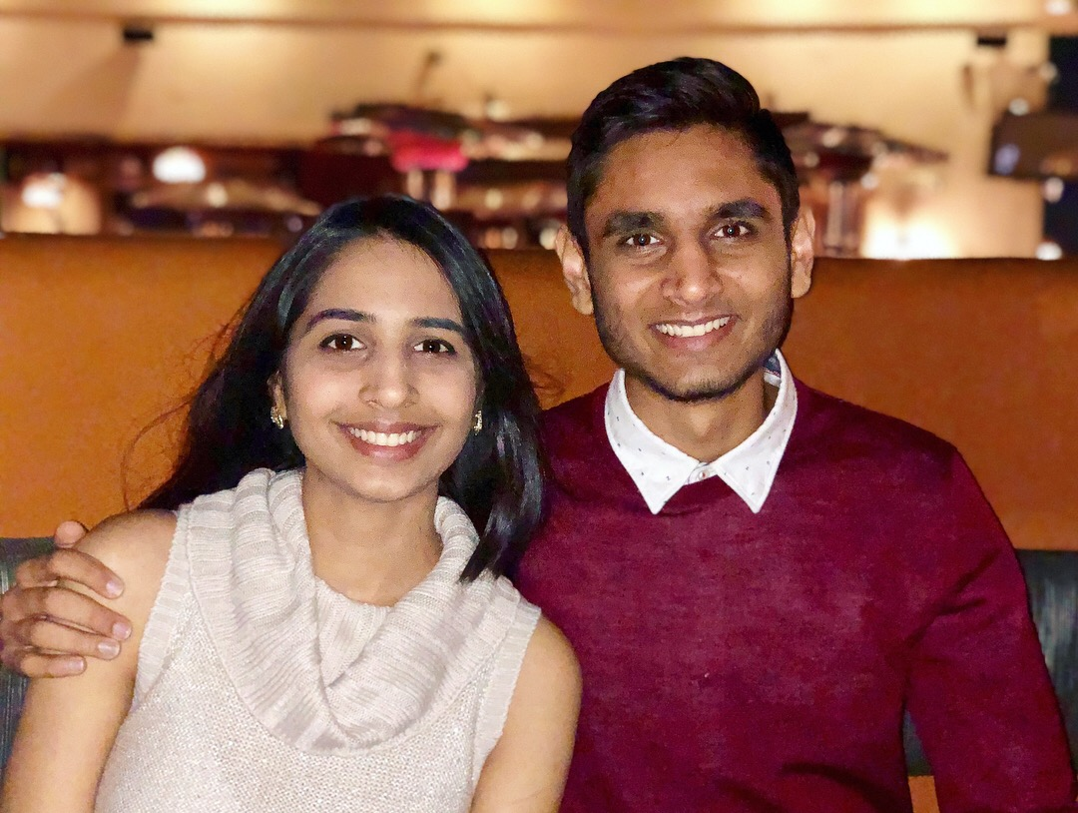

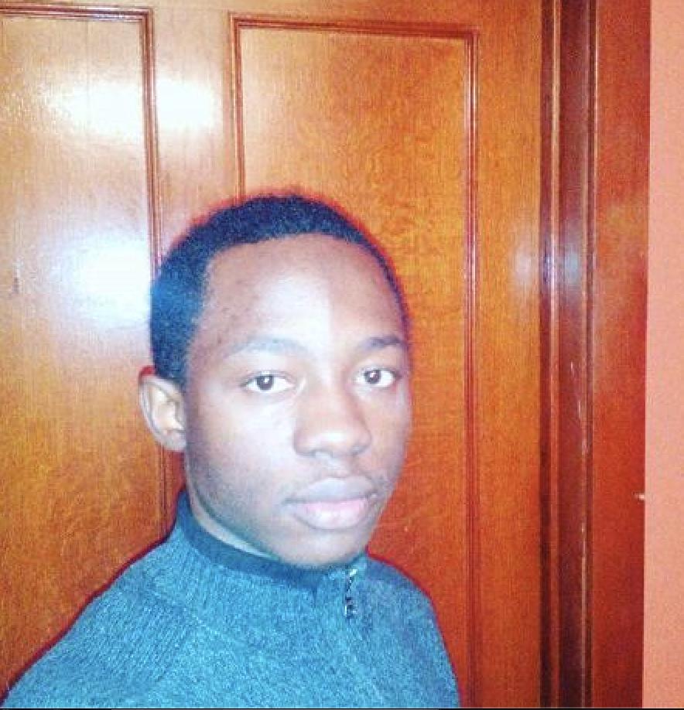



The Team
Nihar
Patel
Henry
Post
Idris
Fagbemi
Divin Gregis
Baniekona
Jimmy
Tran
Yi-Ting
Lin
Project Manager
Developer
Junior Developer
IT Operator
UI/UX Developer
UI/UX Developer

Slide 3
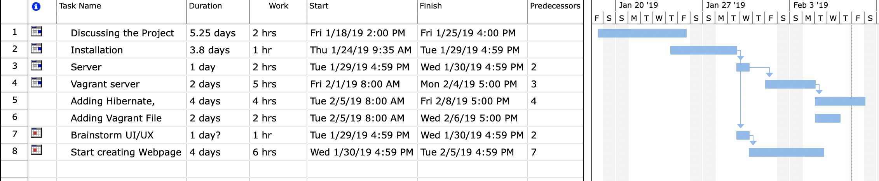
What we planned to accomplish for sprint-01
Decide project requirements
Assign roles to everyone
Get the project started
Creating a good communication system
Everyone on the same page

Slide 4
Project Base Requirements
Java, MySQL, Bash, Kotlin, Python, HQL
Hibernate, Java Server Faces, Spring Boot (webpages)
Language
Servers
Framework
Built/Deploy
MySQL, Apache Tomcat
Maven, Vagrant

Slide 5

Project Base Requirements
Package manager has a lot of packages so that we don’t have to build it from source.
DOWN SIDE: Builds are not deterministic.
a. Packages and dependencies (installers): Java, Maven Tomcat, MySQL
b. Process of Secrets management: No Secrets Management.
c. Capture of application metrics: We have Tomcat logging engine, MySQL database to run analysis on that, Maven to tell how long it takes to deploy.

Slide 6
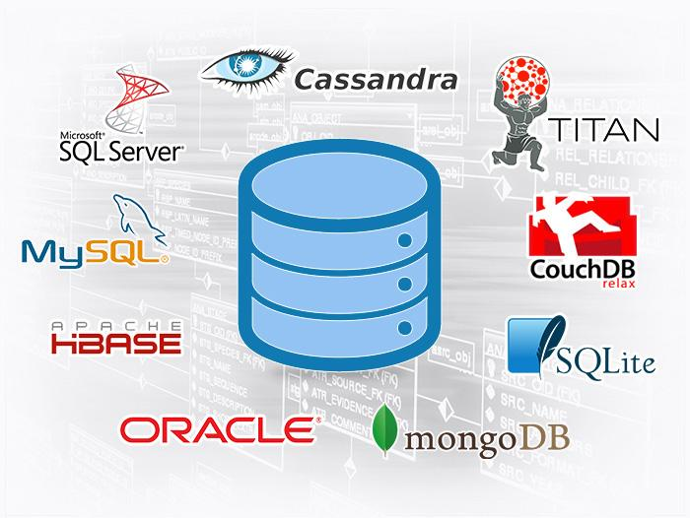
Project Base Requirements
5. Database makes use of master/slave replication:
a. Schema creation: No. We are not going to.
b. Caching layer implementation: No.
c. Master for database writes: No.
d. Slave for database reads: No.
Data encrypted at rest: We don’t have password yet!

Slide 7
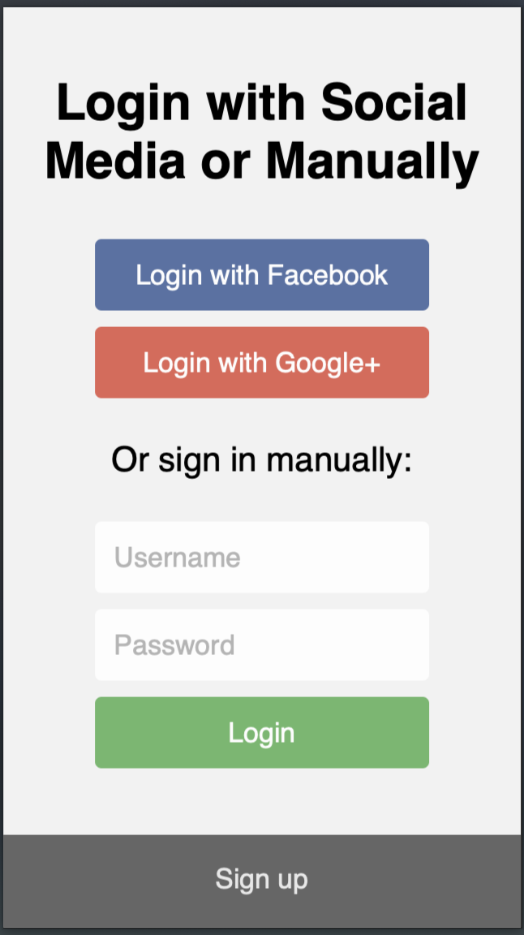
Project Base Requirements
Responsive design
7. Use of https:
a. Self-signed certs: We do not have any.
b. Login authentication mechanism: Yes. We will impose the Nist rule on users because they are simple.
c. Explanation of security assumptions relating to:
i. Firewall: All ports will be locked down except for https and http. No ssh. No remote desktop.
ii. Authentication keys: None. They are in the git history. They are hard coded in the file and they are very simple.
iii. Seeding of usernames and passwords: No.
iv. Pre-seeding databases/datastores with schema and records: We will have them.

Slide 8
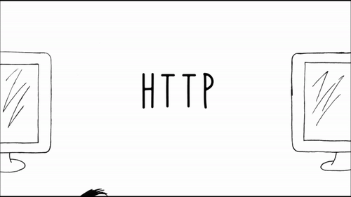
Project Base Requirements
Things we plan to have when we get our authentication and session done:
Different UI for Unauthenticated users:
read/only features
Different UI for Authenticated users:
user account management page
Different UI for Administrative users:
an administrative database dump and restore feature
UI is modified per authenticated user via CSS
Use of user authentication:
a. Must use HTTP Session: We will force https when we are done. Right now we have http.

Slide 9
Project Base Requirements
9. Creation of Dev Environment (local laptop):
a. Must work according to specification: We have a build guide but we do not have automated way to set up an environment.
b. Environment must be configurable via script pre-deploy
i. No manual editing or installing: We do not have an automated development environment.
c. Explanation of UI/UX testing methodology and bug reporting: We do not have any testing methodology.

Slide 10
Project Base Requirements
10. Layout design:
a. Diagrams of site functionality need to match delivered features: We do not have any.
b. Diagrams of colors, fonts, and other usability features: We do not have any.
11. Management of Visio (or comparable) diagram tool of work flow:
We do not have any.

Slide 11
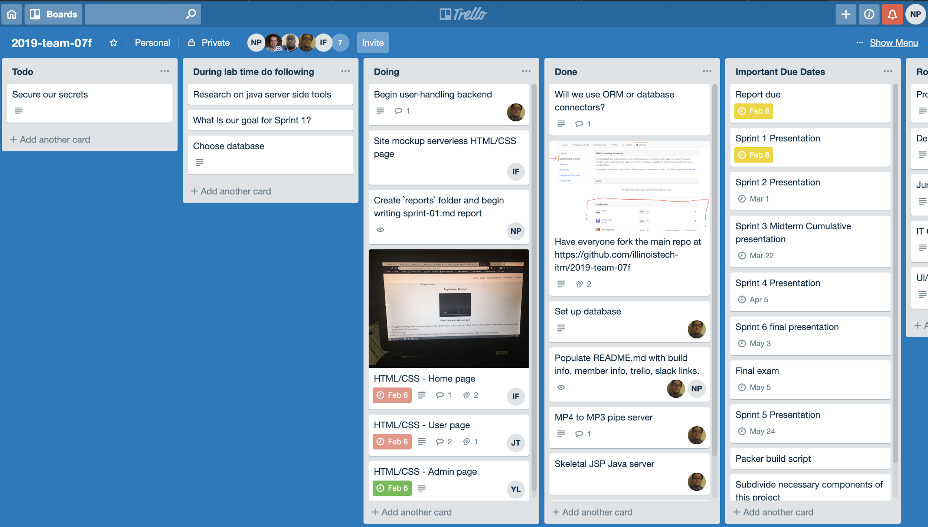
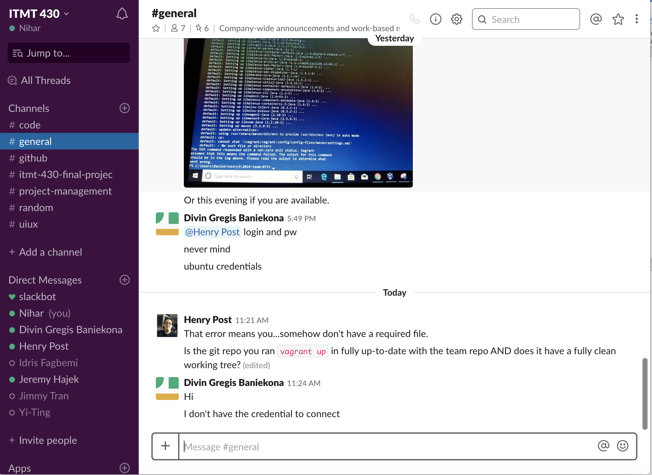
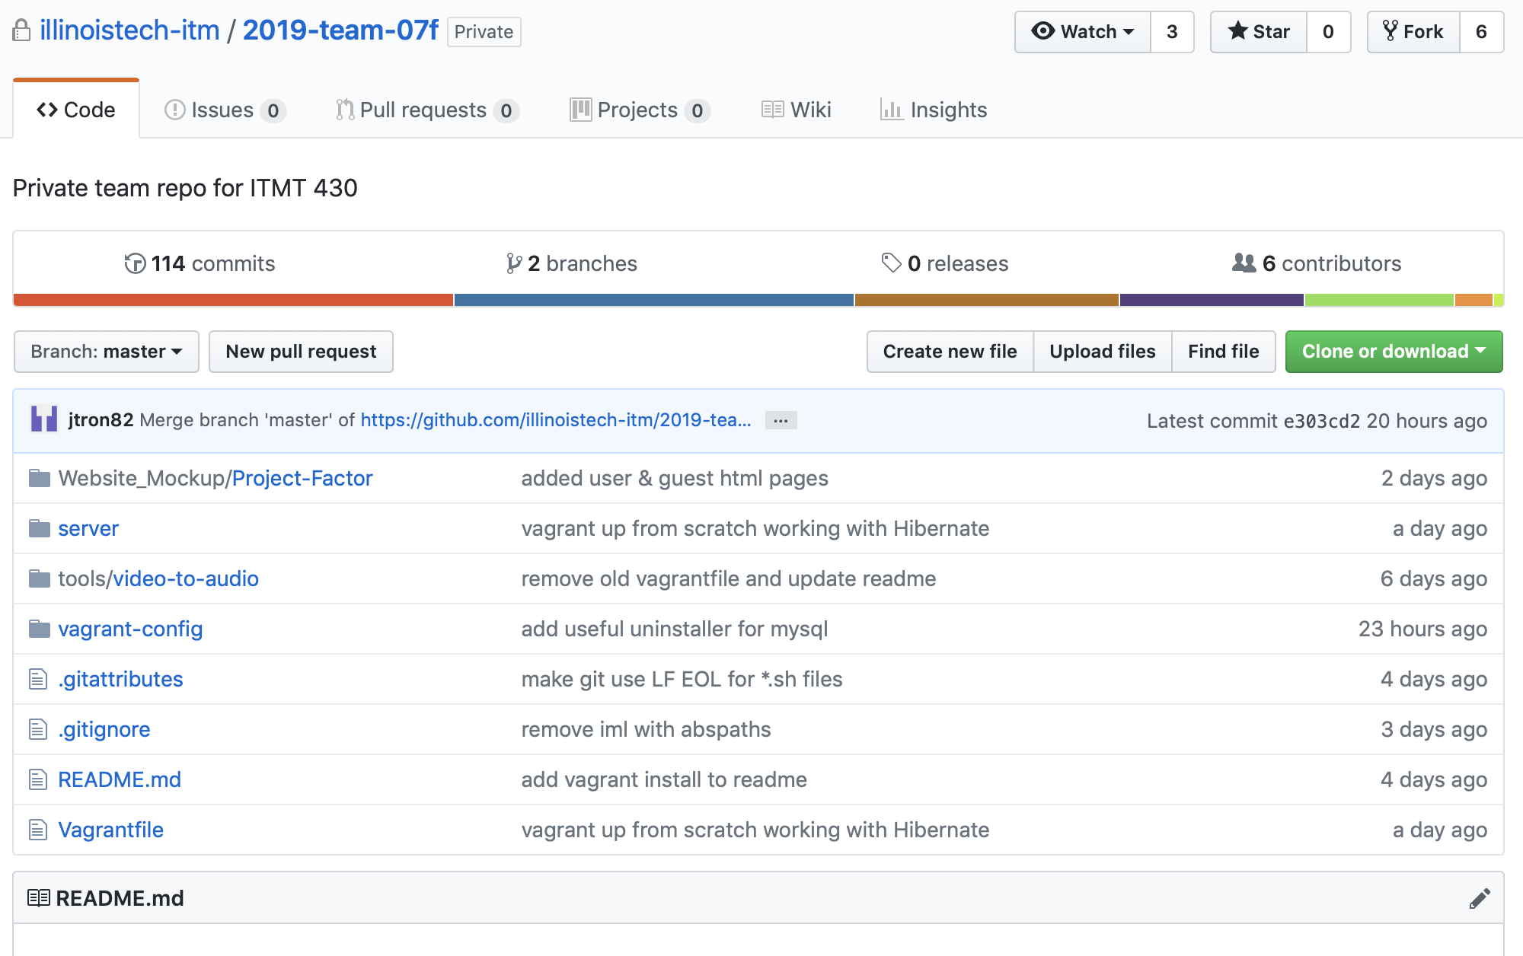
Project Base Requirements
How we manage project progress?

Slide 12
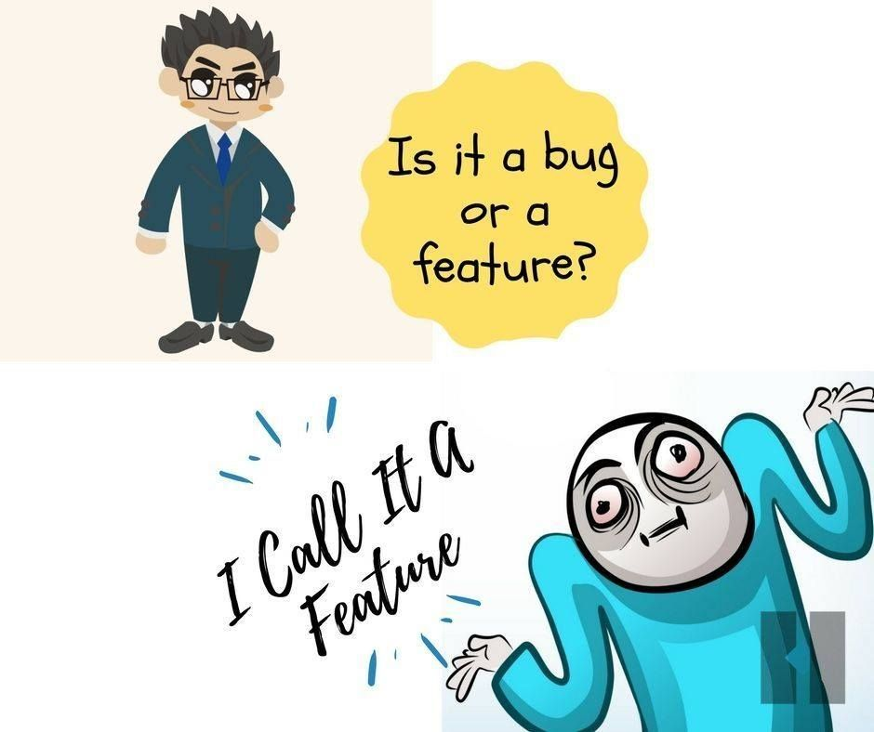
Project Base Requirements
For the FINAL sprint
GitHub Issues to resolve bug posts from UI/UX tester
i. Must post at least 10 bugs in final sprint: We will have it
13. Team must generate at least 15 real “test” user data that is inserted upon instance creation and proper data to test functionality of a system:
a. No system is ever used “blank” always fill it up with real data: We will have them

Slide 13
Goals for next sprint
Create sessions for login / logout
Password encryption
Different profile for unauthorised users
Database relationships
Also, Figure out where and how are we going to store the videos

Slide 14

DEMO!

